Slide 1
Ngee Ann Polytechnic Immersion Program
Presented by CSF02

Slide 2
Variables
Warm welcome to Python!

Slide 3
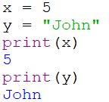
Variables
Containers for storing data values
Created when you assign a value to it
💡​​ | print(): A command that tells Python to show anything within the two brackets on the screen.
Example 1

Slide 4
Variables
Rules for Python Variables
#Legal variable names: myvar = "John" _my_var = "John" myvar2 = "John" MyVar2 = "John
#Illegal variable names: 2myvar = "John" my-var = "John" my var = "John"
- Must start with a letter or the underscore (_) character
- Case-sensitive
- Cannot start with a number
- Only contain letters, numbers or underscores
These are different variables
Example 2

Slide 5
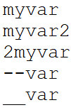
Variables – Exercise 1
Which of these are legal variable names?
1.
✔️
Rules of Python Variables
- Must start with a letter or the underscore (_) character
- Case-sensitive
- Cannot start with a number
- Only contain letters, numbers or underscores
2.
✔️
3.
❌
4.
❌
5.
✔️

Slide 6
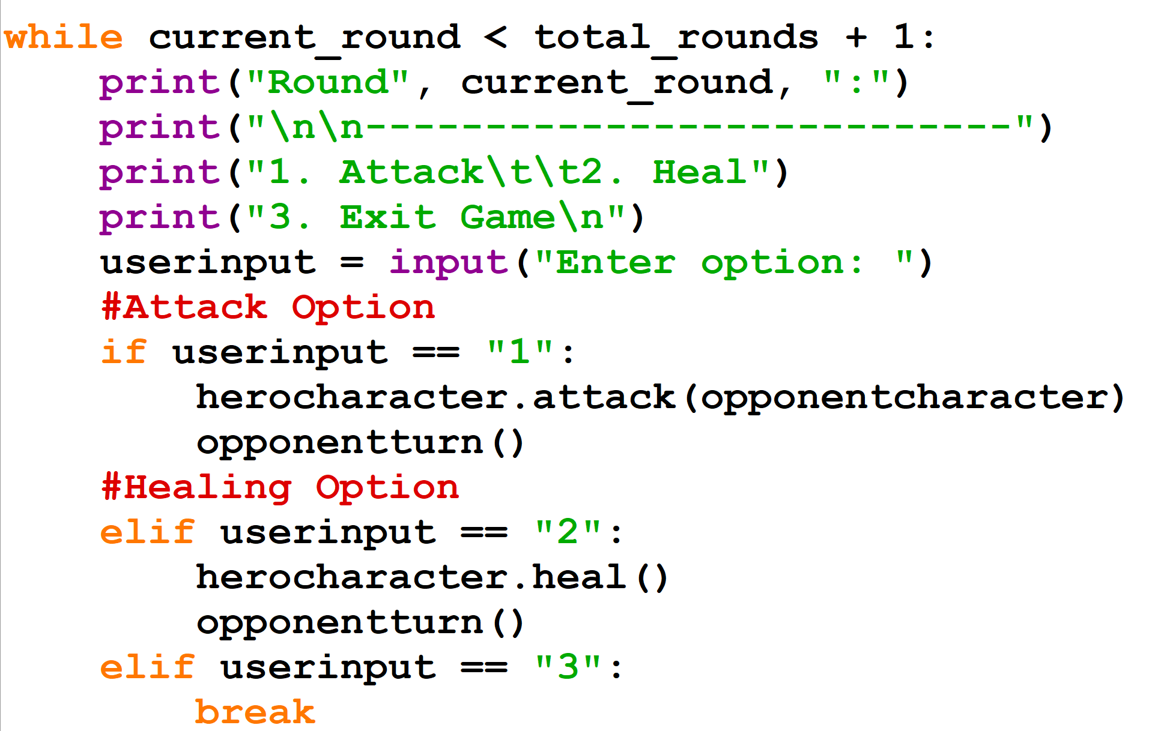
Variables
Comments
- Comments allow us to write text that do not affect the code, but to let users read what the code does
- Denoted by #
Example 3​​
Notes:
Compare example 3 and example 4, showing how that it looks cleaner/understandable with comments

Slide 7
Data Types
What is an integer?

Slide 8
Data Types
Text Type: str
Numeric Types: int, float
Boolean Types: True, False
- Data types are the kind of data to be stored in a variable.

Slide 9
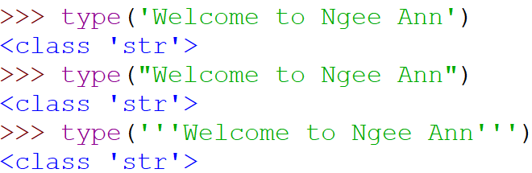
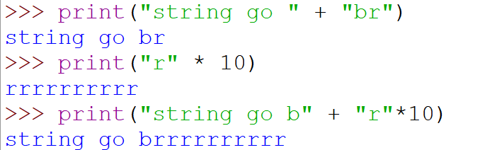
Data Types
Example 5
Str(String)
- Any character, word, numbers or combination of all
- Enclosed within quotes ' " or '''
- Use \" to have quotes within your string
💡​​​​ | type():​​ ​​ A command that tells you the data type of any variable within the two brackets.​​
Example 6 – Fun things to do with strings
Notes:
- Strings can be combined and even multiplied!

Slide 10
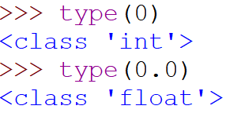
Data Types
Int(Integer)
Float(Floats)
- Whole numbers, positive or negative
- Zeroes are also integers (in python)
- Any number with decimals
Example 8
Example 7

Slide 11

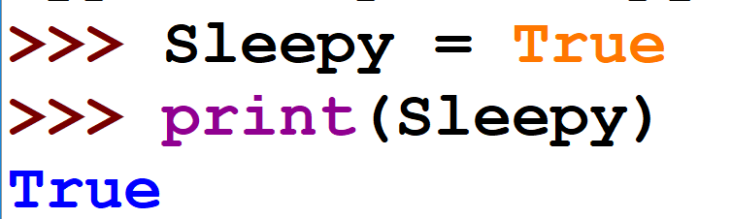
Data Types
Example 8​
Bool(Booleans)
- A boolean value is either True or False.
- Variables with boolean values are often used to keep track of certain conditions within a program.
Example 9

Slide 12
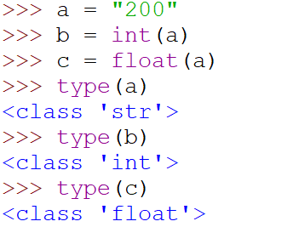
Data Types
Data Type Conversion
In Python, users can change the datatype using commands (assuming it is legal)
Some examples are str(), int(), and float()
Example 10

Slide 13


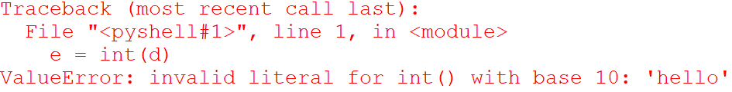
Data Types- Exercise 1
What results will these lines give?

Slide 14
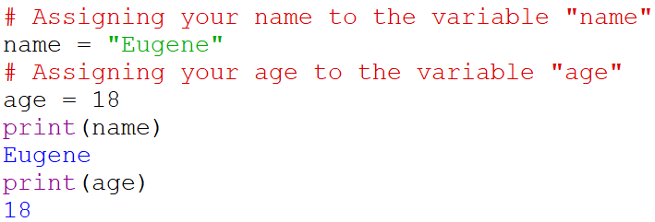
Data Types – Exercise 2
Assign the variable 'name' to your name and the variable 'age' to your age. After that, try printing out both variables.
You can use comments to make the code more understandable.
Notes:
-5th slide when making the example/sample output for the exercise, can include comments to relate to previous slide. Then when presenting to the students can be like "feel free to make use of comments while doing the exercise" also can be phrased better e.g "Assign your name to a variable called 'name'" etc

Slide 15
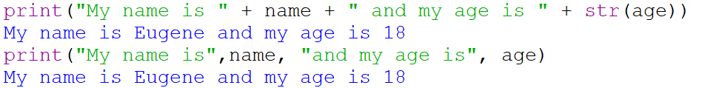
Data Types – Exercise 2 cont.
Now try forming a sentence using your name and age variables using the print statement. (💡Hint: Recall that you can combine strings!)
or

Slide 16
Operators
Operation Strix

Slide 17
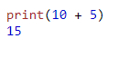

Arithmetic Operator
Operators are used to perform operations on variables and values.
A method of which to provide the computer instructions for logical processes
Example: Addition, multiplication of numerals

Slide 18
Arithmetic
Level 1
Operator | Name | Example | Given y=5; z=3
+ | Addition | x = y + z
- | Subtraction | x = y - z
X = 8
X = 2

Slide 19
Arithmetic
Level 2
Operation | Name | Example | Given y=5; z=3
*​ | Multiplication​ | x = y * z​
/​ | Division​ | x = y / z​
X = 15
X = 1.66666666667

Slide 20
Arithmetic
Level 3
Operator | Name | Example | Given y=5; z=3
%​​ | Modulus/Remainder​​ | x = y % z​​
**​​ | Exponentiation​​ | x = y ** z​​
//​​ | Floor division​​ | x = y // z​​
X = 2
X = 125
X = 1

Slide 21
Order of Arithmetic Operators
Order of precedence (highest to lowest) is:
Operator | Description
( ) | Parentheses (grouping)
** | Exponentiation (raise to a power) | right to left
* / // % | Multiplication, division, floor division, modulus | left to right
+ - | Addition, subtraction | left to right
= | Assignment

Slide 22
Challenge!
In what order would you solve this mathematical equation?
5
4
1
2
3

Slide 23
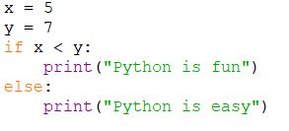
Comparison Operator
Used to compare two different variables and produce a Boolean
Boolean produced is dependent on the comparison operator used
Example: Checking whether a number is bigger than the other.

Slide 24
Comparison
Level 1
Operator | Name | Example
== | Equal | x == y | When x = 5, y = 5
!= | Not equal | x != y | When x = 5, y = 0
Ans: 5 == 5 (True)
Ans: 5 != 0 (True)

Slide 25
Comparison
Level 2
Operator | Name | Example
> | Greater than | x > y | When x = 5, y = 5
< | Lesser than | x < y | When x = 6, y = 5
Ans: 5 > 5 (False)
Ans: 6 < 5 (False)

Slide 26
Comparison
Level 3
Operator | Name | Example
>= | Greater than or equal to | x >= y | When x = 5, y = 0 When x = 5, y = 5
<= | Lesser than or equal to | x <= y | When x = 2, y = 5 When x = 5, y =5
Ans: 5 >= 0 (True)
Ans: 5 >= 5 (True)
Ans: 2 <= 5 (True)
Ans: 5 <= 5 (True)

Slide 27
Challenge!
Samuel has three phone brands along with their respective costs, Samsung = $100, XiaoMi = $500, Apple = $600, help him find out if the scenarios are True or False!
Scenarios | Result
Samsung < XiaoMi + Apple
XiaoMi == 2 * Samsung + 50
Apple <= Samsung – XiaoMi
Apple > Samsung % Apple
Samsung != XiaoMi
True
False
False
True
True
Notes:
True
False
False
True
True

Slide 28
Conditional statements
What if?

Slide 29
Logical Operators
Operators that connect two or more expressions to determine the Boolean value of the compound condition.
Type | Boolean Statement
OR | Q = A OR B
AND | Q = A AND B
NOT | Q = NOT A

Slide 30
Logical Operators
A | B | A and B | A or B | not A
False | False | False | False | True
False | True | False | True | True
True | False | False | True | False
True | True | True | True | False
Notes:
So in a nutshell, for the AND operator, both variables A and B have to be True in order for the outcome to also be True, else it will always be False. On the other hand, for the OR operator, either A or B needs to be True in order for the outcome to be True, else it will be false. Lastly, the not operator is pretty straightforward and just reverses the value of A from True to False and False to True.

Slide 31
Order of operations
Order | Logical Operation
1 | Parentheses
2 | NOT
3 | AND
4 | OR
Order 1
Order 2
Q = (A AND B) OR (A AND C)
Order 3

Slide 32
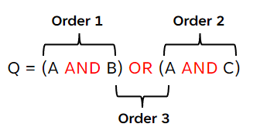
Booleans (Activity)
Guide:
What will the outcome of the expression be?
Expression | True/False
NOT True
True AND False
False OR NOT False
(True AND True) OR False
False
False
True
True

Slide 33

Input
Python allows us to ask the user for input
Input allows us to ask the user questions and for the user to reply
Suppose we want to ask the user for their name, we can present it like this in code
name = input("What's your name?")
print(name)

Slide 34
"If" Statements
In many programs, decisions are usually made using the if and else statements
These decisions are made by factoring in conditions, hence these statements are also known as conditional statements
How to use it:
Example:
If condition (is true):
Do this!
Else (if condition is false):
Ask for temperature
Get temperature
Do this!
Do this instead!
If temperature > 37.5
Else
You have a fever!
You do not have a fever!
Notes:
Now that we understand how Boolean statements work, we can look at if statements. We make decisions every day in our lives, and usually when we make decisions, we will think of something along the lines: "If this happens, then I will do this, or else if that happens then I will do that". For example, you might be thinking "if it rains, then I will sleep, else if it does not, then I will go and play basketball with my friends". Just like us, in many programs, decisions are usually made using the if and else statements. How these statements are used in programming usually follows a "if condition is true, do this, else if condition is false, do this instead" rationale. If we look at the bottom right flowchart, we can see that if a program needs to check whether the user has fever or not, the first step would be to ask for temperature, then obtain temperature, and then use the "if" and "else" statements to find out whether or not the user actually has a fever.

Slide 35

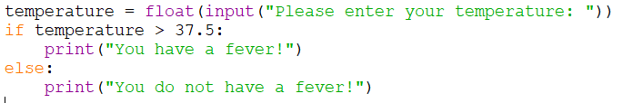
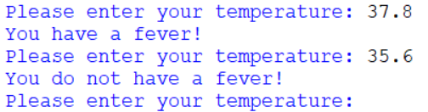
"If" Statements - Example
if temperature > 37.5:
Code:
print("You have a fever!")
Result:
else:
print("You do not have a fever!")
Notes:
To demonstrate this example, let us look at how this program could be coded. If we look at the highlighted line on the left, we can see that in this case, the condition for this program is "if temperature is more than 37.5 degrees". Therefore, if this condition is true, we can tell the user that the user indeed has a fever, and if it is false, we tell the user that they do not have a fever. On the right, we can see the code and the results that confirm that our program is working as intended.

Slide 36
Challenge!
if score ________:
John wants to create a program that helps him to determine whether he has passed his examination papers or not
Using "if" statements, can you help him to create this program?
Passing score: 50 and above; Failing score: 49 and below
print("Congratulations, you passed your paper!")
else:
print("You failed your paper, try again next time!")
Notes:
Now that you understand how if statements work, here is a challenge! Let's say that John wants to create a program that helps him to determine whether he has passed his examination papers or not. He knows that the passing score is 50 and above, and the failing score is 49 and below. Using "if" statements, can you help him to create this program? Let us first try to figure out the condition in order for this program to work. Looking at the right of this page, are you able to fill in the highlighted underline?

Slide 37
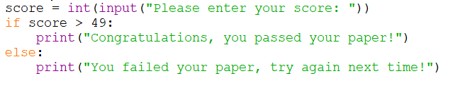

"If" Statements - Activity
if score > 49:
Code:
print("Congratulations, you passed your paper!")
Result:
else:
print("You failed your paper, try again next time!")

Slide 38
Loops!
Around & around!

Slide 39
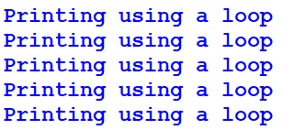
Loops - Introduction
- Loops allow you to repeat a set of statements multiple times
Example:
Repeat a print statement

Slide 40
Loops - While
How it looks like
while (condition):
Code
Usage:
Generally used to repeat a block of statements an unknown number of times, until a condition is met.

Slide 41
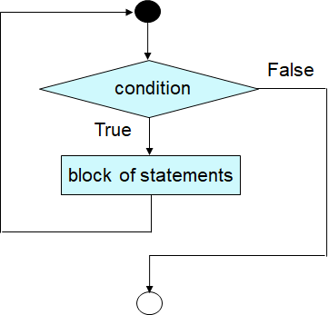
Loops - While
How it works
1. Check the condition given
2. If the condition is true, execute the block of statements in the loop
3. Repeat from step 1 until condition is false

Slide 42
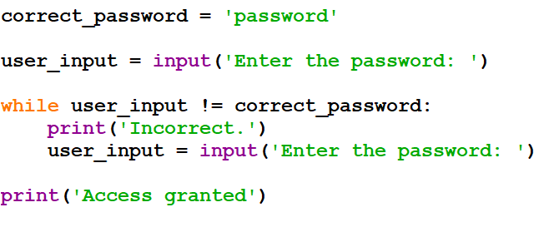
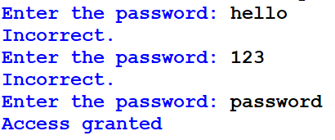
Loops - Examples
Code
Output

Slide 43
Loops - For
How it looks like
for (item) in (list):
Code
Usage:
When going through a specific list and processing each item in order once
for (number) in (range):
Code
Usage:
When running a block of code for a specified number of times

Slide 44
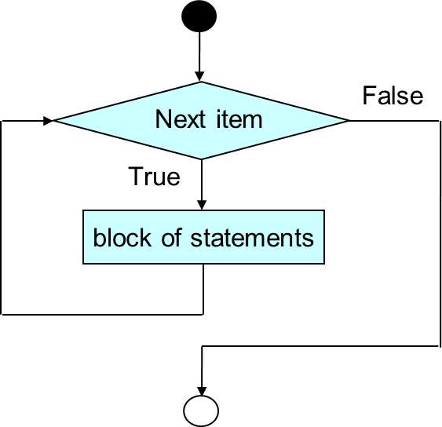
Loops - For
How it works
1. Retrieve item from a list or a number from a range sequence
2. Executes statements within the loop
3. Repeat from step 1 until all items in the list or range have been gone through

Slide 45




Loops - Examples
for (item) in (list):
for (number) in (range):

Slide 46
Challenge!
Find the sum of all numbers from 1 to 100.
(Try both while and for loops if there is sufficient time)
Sample output:

Slide 47
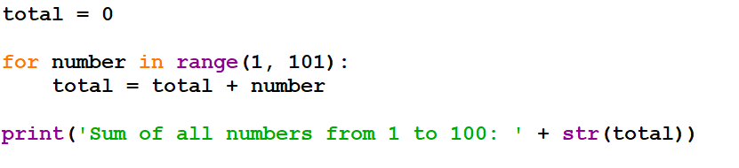
Suggested Solution
Using for loop:

Slide 48
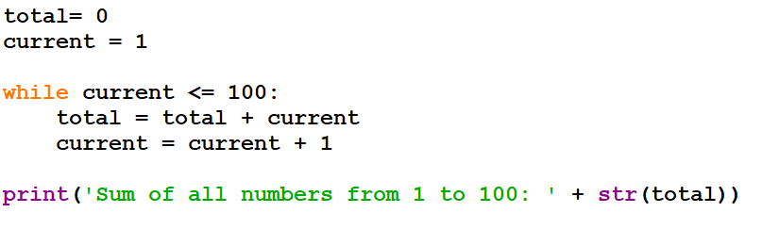
Suggested Solution
Using while loop:

Slide 49
Loops – Control Flow
'break' statement:
- Used to exit from a loop
- Terminates the loop
- Program continues at the first statement after the loop

Slide 50
Loops – Control Flow
'continue' statement:
- Used to skip to the next iteration of the loop
- Terminates the current iteration
- Program continues at the next iteration if condition is true

Slide 51
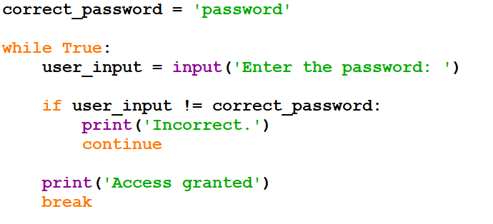
Loops - Examples
Code
Output

Slide 52
Data Structure

Slide 53
List
Lists are declared using [ ]
Lists can hold multiple items. It is a variable that can store other variables

Slide 54
Accessing Items
Lists have register numbers like students (aka index)
Their index starts from 0
What is the index of "Ali"?

Slide 55

Accessing Items
Syntax:
List_name[index]
Example:

Slide 56
Adding Items
Students can join the class
For example, 2 new students, Dominic and Jefferey join the class
Syntax:
List_name.append(value)

Slide 57

Adding Items
Example:

Slide 58
Deleting Items
Students can also leave the class
For example, Mary leaves the class because she has to eat dinner
Syntax:
List_name.remove(value)

Slide 59

Deleting Items
Example:

Slide 60
Changing Items
Students might also change their names
For example, Jeffery changes his name to Sean
Syntax:
List_name[index] = (value)

Slide 61

Changing Items
Example:

Slide 62
Challenge!
The teacher made a mistake and now there are too many Johns in the class list!
Remove 1 "John"
Change 1 "John" to the name of "Johan"
Add your name to the class list
Sample output:

Slide 63
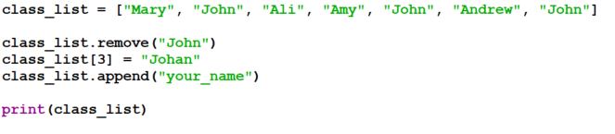
Suggested Solution

Slide 64
Python Projects
Gamify it!

Slide 65
Python Games
Simp City
Hero's Combat

Slide 66
Thank you
Any Questions?

Slide 68
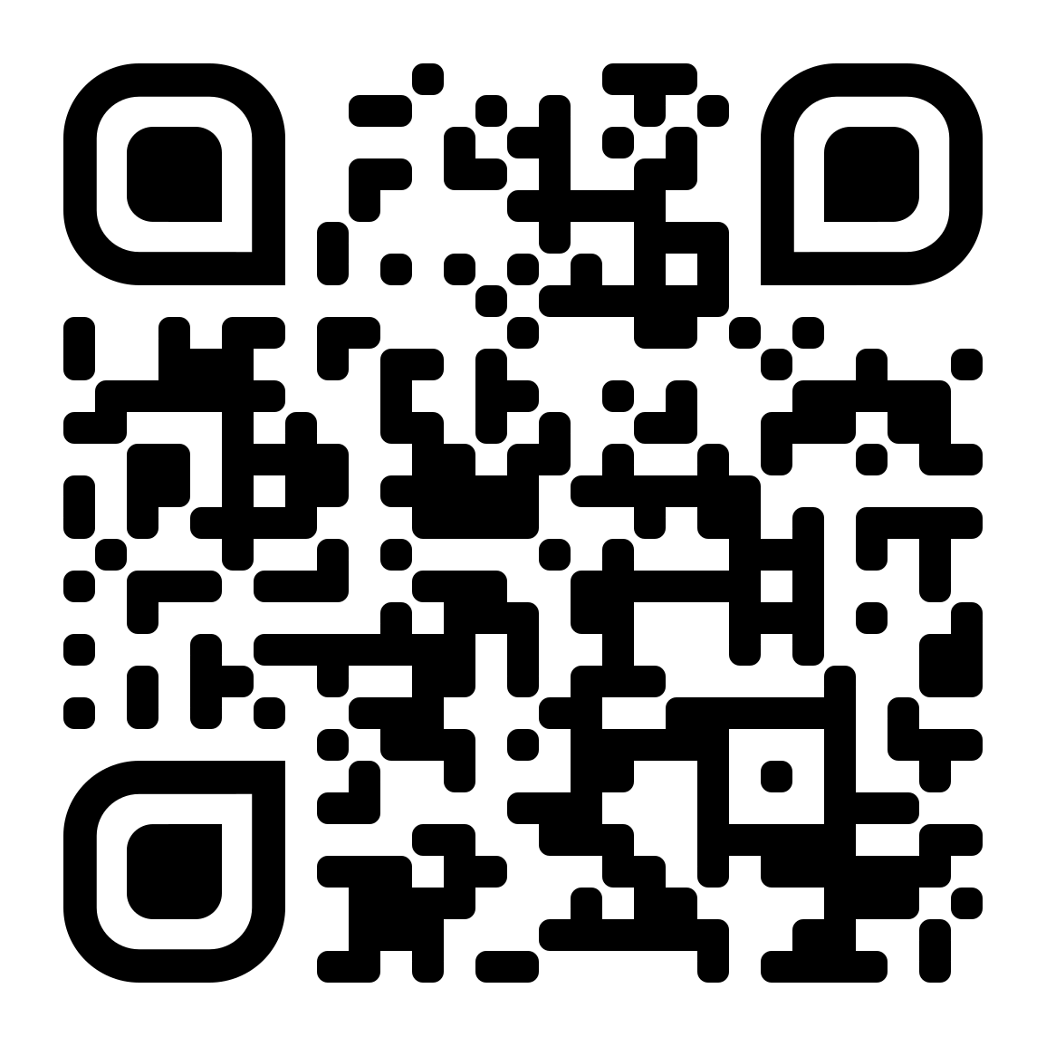
Feedback Form!
tinyurl.com/NPImmersionProgramme

